Slide 1
Performance Metrics

Slide 2
Motivation
You built a classification model to identify wafers affected by Fin Res or not.
You have a test set where you manually labeled 100 wafers with Fin Res or not.
How would you measure the performance of your model?
What are some things you have to consider?
Some basic ideas/terminology:
Classification Model – Predict yes/no for a certain question
Training Set
Test Set

Slide 3
Types of Performance Metrics for Classification Models
Accuracy
Precision, Recall, F1-score
Log Loss, Area Under Curve (AUC)
Others

Slide 4
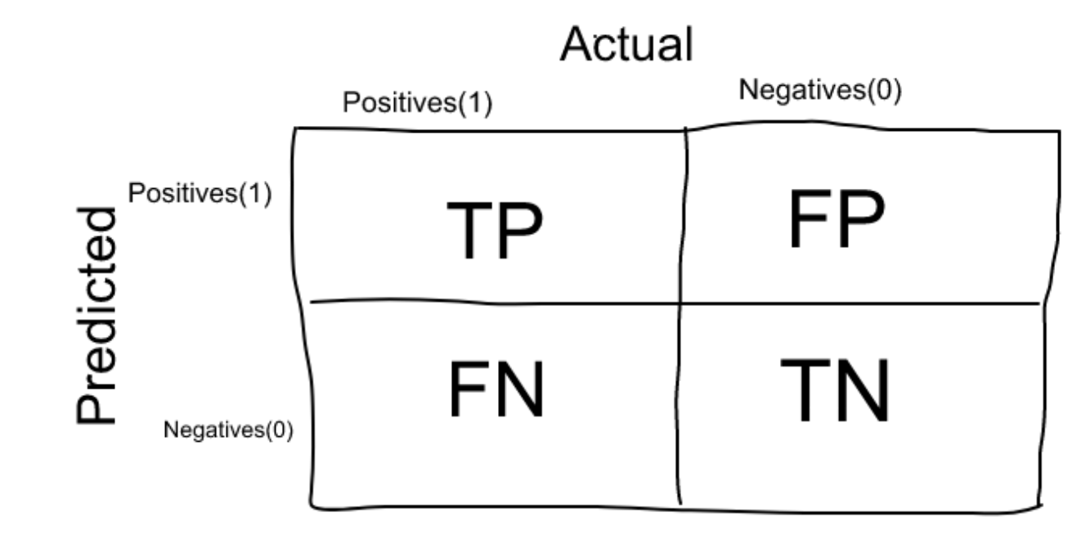
The Confusion Matrix
Actual Fin Res classification confirmed by you
Your model classified Fin Res Correctly
Your model classified Fin Res
But the wafer has no Fin Res
Your model’s prediction
Your model classified no Fin Res
Your model classified no Fin Res Correctly
But the wafer has Fin Res
Question: How would you express “accuracy” with these variables?

Slide 5
What is accuracy?
Number of correct predictions over all predictions
Therefore, Accuracy = (TP + TN) / (TP + TN + FP + FN)
Pretty good performance metric, very intuitive and easy to understand and explain to someone else.
You trained your model on a dataset with half Fin Res, half non-Fin Res wafers. When you tested the model on a test set, model came out with 97% accuracy.
When would using accuracy actually hurt you?

Slide 6
Consider this Scenario
You built a model to predict whether a patient has cancer
However out of 1000 patients only 5 of them have cancer
In your training set only 0.5% of the data is labeled yes for cancer
Do you see the issue?
Your model can simply say “no cancer” for all patients. Then, when you test the model in a test set, you will get 99.5% accuracy and think you built a fantastic model.
However, your model is simply telling you that no one has cancer. (Predicting the Majority Case)
Now the 5 people who have cancer will not get treatment and that is unacceptable.
If you have a very unbalanced data set, DO NOT RELY ON ACCURACY!

Slide 7


Precision/Recall
Precision = $\frac{TP}{TP+FP}$
Recall = $\frac{TP}{TP+FN}$

Slide 8

Precision
How many of our model’s positive predictions were correct?
How precise are we at making positive predictions?
Note: we don’t care about any predictions we think is false. If you only predict 1 cancer case, as long as that person has cancer, you have 100% precision (even though you missed 4 cancer patients)
You are concerned about the “cost” of false positives (what you predict is true, when it’s actually false)
When would you want to use precision?
Precision = $\frac{TP}{TP+FP}$
Notes:
Identifying spam. Identifying guilt.

Slide 9

Recall
How many of the actual positives did our model catch?
Instead of capturing positive cases correctly, like Precision, Recall is more about wanting to capture all cases that are labeled as positive.
You are concerned about the “cost” of false negatives (what you predict is false, when it’s actually true)
When would you want to use Recall?
5
95
Recall = $\frac{TP}{TP+FN}$

Slide 10

Predicting the Majority Case
Scenario: only 5 patients out of 1000 have cancer. Our model predicts all patients don’t have cancer
Accuracy = (0+995)/(0+0+5+995) = 99.5%
Precision = 0/(0+0) = N/A
Recall = 0/(0+5) = 0
Note: For Precision, we only care about the positive predictions we make, in this case we made 0 positive predictions, so the precision is N/A.
Recall is about capturing all the positive cases. In this case we caught no positive cases.
5
995
Precision = $\frac{TP}{TP+FP}$
0
0
0
1000
5
995
Recall = $\frac{TP}{TP+FN}$

Slide 11
Slightly better than Predicting the Majority Case
Scenario: only 5 patients out of 1000 have cancer. Our model predicts all patients don’t have cancer
Accuracy = (1+995)/(1+0+5+995) = 99.6%
Precision = 1/(1+0) = 1
Recall = 1/(1+4) = 0.2
Note: For Precision, we don’t care about any predictions we think is false. If you only predict 1 cancer case, as long as that person has cancer, you have 100% precision (even though you missed 4 cancer patients)
Recall is about capturing all the positive cases. In this case we caught 1/5 of positive cases.
5
995
Precision = $\frac{TP}{TP+FP}$
1
0
1
999
4
995
Recall = $\frac{TP}{TP+FN}$

Slide 12
Terrible Model that Predicts everyone has Cancer
Scenario: only 5 patients out of 1000 have cancer. Our model predicts all patients don’t have cancer
Accuracy = (0+5)/(0+0+5+995) = 0.5%
Precision = 5/(5+995) = 0.005
Recall = 5/(5+0) = 1
Note: Precision is about “how precise are our positive predictions?” In this case, not very precise at all.
Recall is about capturing all the positives in this case, we caught them all, even though we have 995 false positives.
5
995
Precision = $\frac{TP}{TP+FP}$
5
995
1000
0
0
0
Recall = $\frac{TP}{TP+FN}$

Slide 13
Perfect Model
Scenario: only 5 patients out of 1000 have cancer. Our model predicts all patients don’t have cancer
Accuracy = (5+995)/(0+0+5+995) = 100%
Precision = 5/(5+0) = 1
Recall = 5/(5+0) = 1
Note: As expected, perfect model will have perfect score for all three performance metrics
5
995
Precision = $\frac{TP}{TP+FP}$
5
0
5
995
0
995
Recall = $\frac{TP}{TP+FN}$

Slide 14
Realistic Example
Scenario: only 5 patients out of 1000 have cancer. Our model predicts all patients don’t have cancer
Accuracy = (3+984)/(0+0+5+995) = 98.7%
Precision = 3/(3+11) = 0.214
Recall = 3/(3+2) = 0.6
Note: At first glance, it looks like the model is doing pretty well, only 13 mistakes out of 1000, however, if you take into consideration how skewed the data set is (only 5 true cancer patients), 13 mistakes is a lot. The accuracy doesn’t capture this, but precision and recall scores are not great. For all the positive predictions the model made, it’s not very precise, it made 3 correct positive predictions but 11 incorrect positive predictions. Also, it was not very successful in capturing all the positive predictions. Only caught 3 out of 5. This is a good example of not relying on only Accuracy.
5
995
Precision = $\frac{TP}{TP+FP}$
3
11
5
995
2
984
Recall = $\frac{TP}{TP+FN}$

Slide 15

How does classification threshold impact Precision and Recall?
In most classification models, you generate a probability to predict positive or negative. This is called the classification threshold.
For example, >50% predict positive, <=50% predict negative
You can tune the classification threshold to tune the model towards higher Precision or Recall.
Consider a classification model that separates email into two categories: “spam” or “not spam”. If you raise the classification threshold, what will happen to precision? What will happen to recall?
Notes:
Precision is TP/TP + FP. Increasing the classification threshold means you predict fewer positives and more negatives. That means your # of TP will decrease or stay the same and the number of FP will also decrease or stay the same. Therefore, in most cases, your precision will probably increase.
Recall is TP/TP + FN. Increasing the classification threshold means you predict fewer positives and more negatives. That means your # of TP will decrease or stay the same and your # of FN will increase or stay the same. Therefore, your recall will either decrease or stay the same.

Slide 16
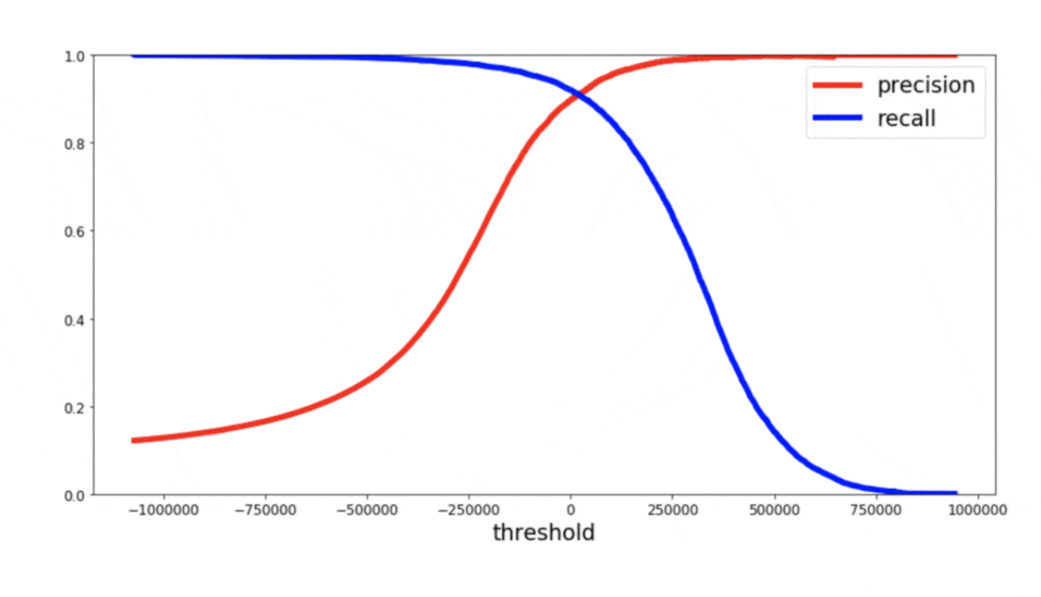
Precision/Recall Trade off
As you change the classification threshold, there is likely going to be a tradeoff between Precision and Recall
Keep that in mind when building your model
Do you care more about precision, or recall, or do you want both to maximize both?

Slide 17
F1 Score
You never want to only depend on Precision or Recall. Even though you might want to bias towards one or the other sometimes.
Even though you would rather falsely predict cancer than miss a patient’s cancer, you can’t go assuming every patient has cancer.
F1 score allows us to combine Precision and Recall into 1 metric that we can optimize. How would you do that?
We can take the average of Precision and Recall…
Look at our horrible model example (predict everyone has cancer). Average of Precision and Recall is 0.5025. Not nearly low enough to reflect how bad this model is
Take harmonic mean: 2*Precision*Recall/(Precision + Recall) = 2*1*0.005/(1+0.005) = 0.010

Slide 18
I know this gets confusing… Here are some key take-aways:
When you care more about the cost of false positives, you should pay attention to precision
Falsely classifying an email as SPAM
When you care more about the cost of false negatives, you should pay attention to recall
Falsely saying your patient does not have cancer when they actually do
There is trade off between recall and precision
You never want to only depend on one or the other, the F1 score is a good way to optimize both.
Though you sometimes want to bias towards one or the other depending on your model’s purpose/

Slide 19
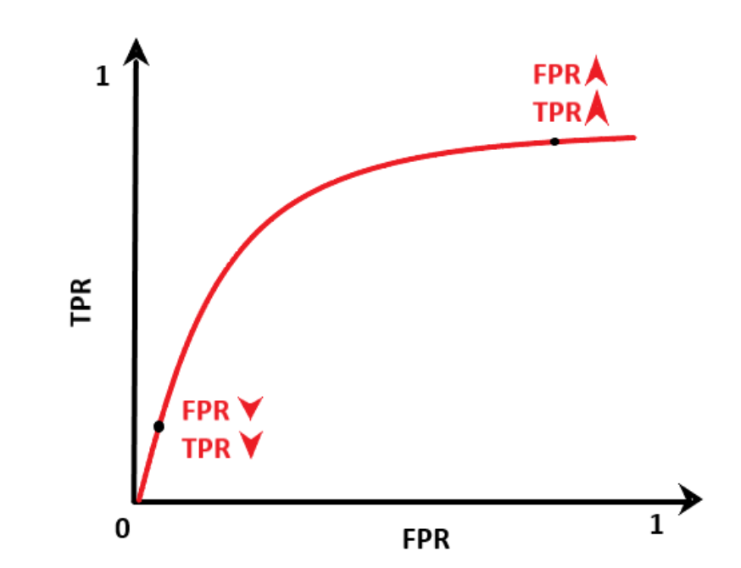
ROC curve
Images from: https://www.analyticsvidhya.com/blog/2020/10/how-to-choose-evaluation-metrics-for-classification-model/
Receiver operator characteristic
Invented during WW2 by electrical engineers to use radars to detect planes.
Low classification threshold, you are very lax in labeling objects in the sky as planes. As a result, you’ll likely catch most of the planes, but you will also accidentally identify many birds as planes
True Positive Rate = TP/ (TP+FN) aka Recall
How many of the planes did your model catch?
High classification threshold, you are very strict and barely classify any planes. As a result, you don’t catch many planes, but you also don’t accidentally call birds planes as well.
False Positive Rate = FP/ (FP+TN)
How many birds did your model catch, thinking they’re planes?

Slide 20
You want your model to have an ROC curve that bows out above the y=x line because this tells you that on most classification thresholds, your model will provide a higher TPR than FPR.
This means your model performs better than a model that’s making random classifications
A model that does completely randomly classifications will have an ROC curve that’s a straight line (y=x)
To determine how much your ROC bows out, you can take the area under the curve. The higher AUC, the better your model is.

Slide 21
Area under the curve
The ROC curve takes the classification threshold out of the equation.
If you had model A and model B, you can compare the two models by plotting the ROC curve without having to worry about different classification thresholds.
The model that bows out more will provide a higher TPR:FPR ratio which is what you desire.
You can take the area under the curve to calculate how much the ROC curve bows out.

Slide 22
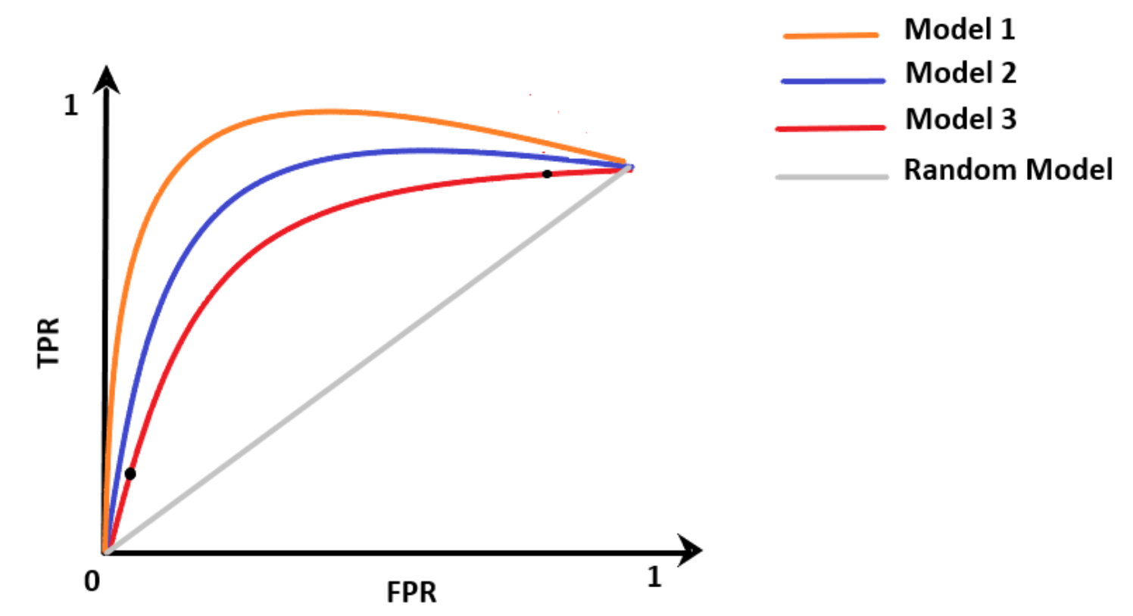
Classification threshold
0.2
0.8
In this example, Model 1 is better than the other models because at any given classification threshold, it will have a higher TPR than FPR.

